Slide 1

Analytical crm analysis for bank
DETAILED Analysis OF factors responsible for customer churn & identifying PROFITABLE customer segments
Pratik nandanwar

Slide 2
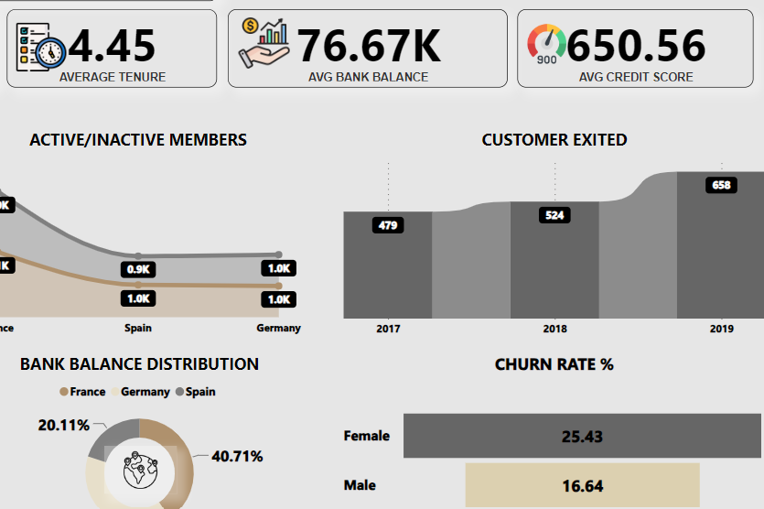
COLUMBIA BANK
Columbia bank is a chain of bank
which started its operations in 1996.
The mission of the bank is to provide accessible and efficient services and serve the respective communities.
Currently the bank operates in
FRANCE
SPAIN
GERMANY
Columbia bank facilities provide a wide array of services such as:
INTERNET BANKING
LOAN SOLUTIONS
INVESTMENTS SOLUTIONS
LOCKER SERVICES

Slide 3

OBJECTIVES
Data Manipulation & querying & analysis with SQL.
Data Analysis and Visualization with Power BI
Determine the key factors contributing to customer churn.
Identify profitable customer segments and target them with tailored services.
Establishing & analyzing correlations between multiple key indicators influencing churn rates at bank.
Suggestions regarding to maximizing retention rates & minimizing churn rates.

Slide 4




OVERVIEW OF DATA
CUSTOMER AVERAGE SALARY
100.45K
CURRENTLY OPERATING AT
COLUMBIA BANK
CUSTOMER AVERAGE TENURE
4.45 YEARS
CUSTOMER AVERAGE BANK BALANCE
76.67K
CUSTOMER AVERAGE CREDIT SCORE
650.6
PRODUCTS OFFERED BY BANK
4

Slide 5
METHODOLOGY
1-Data cleaning
Raw data source was cleaned using EXCEL &processed by power bi DAX functions to eliminate any possible error in results and insights and eliminate errors.
2-Data analysis
The cleaned & processed data was then exported to SQL and data was manipulated in objective to extract insights for the results.
3- Deriving insights
Patterns and logics were observed in data & based on it definitive insights was derived for further suggestion and strategic planning presented in detail in document file.
4-Suggestions & advice for further operations.
The insights obtained is presented and can be used to make strategic planning & management for achieving the objectives for reducing bank churn & optimizing customer experience.

Slide 6
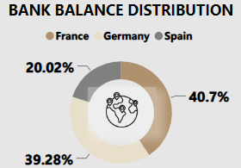


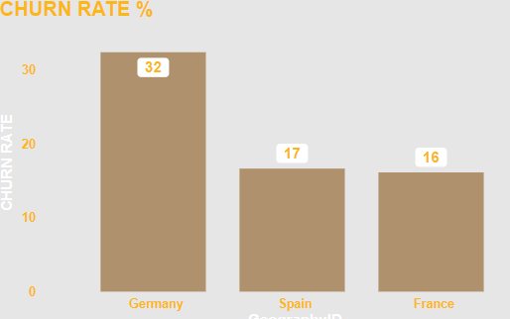
Objective key findings
Distribution of balance across branches
Female customers has the high average salary compared to males but greater churning rate which indicated they are churning the bank due to lack of services and female centric services shall be updated offered by the bank .
Highest distribution % of bank balance was observed from France.
As well France has the lowest churn rate & Germany had the highest churn rate.

Slide 7
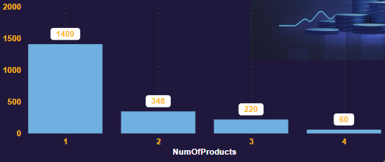
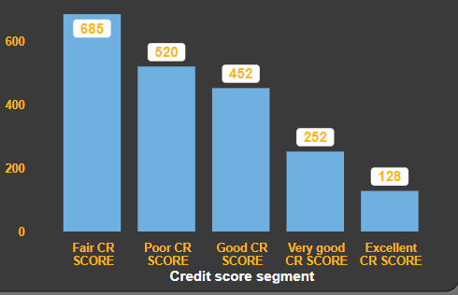
OBJECTIVE KEY FINDINGS
ACTIVE & INACTIVE CUSTOMERS
PRODUCTS USED BY CHURNED CUSTOMER
COUNT OF CUSTOMERS EXITED/ CREDIT SCORE SEGMENT
Almost near to half of the customers are not active in the bank. it indicates a significant challenge in customer engagement and retention.
Strategies like rewards,offers,low interest rates,prompt customer support shall be provided to increase members activity.
Customers who use only one product may have limited engagement with the bank compared to those who use multiple products.
Implement retention strategies tailored to customers who use only one product, such as personalized outreach, loyalty rewards, or incentives or more products shall be promoted for use to encourage broader engagement.
Customers with fair credit scores may have limited access to credit or financing options, making it more difficult for them to manage their financial needs and obligations.
Implement retention strategies targeted specifically at customers with fair credit scores, such as personalized outreach, financial wellness programs, or credit-building initiatives.

Slide 8
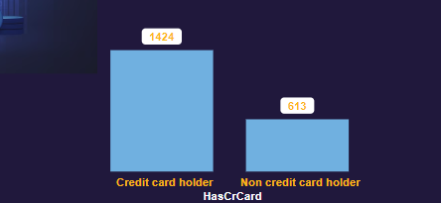
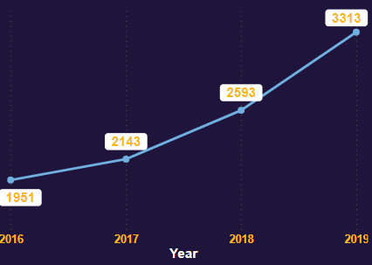
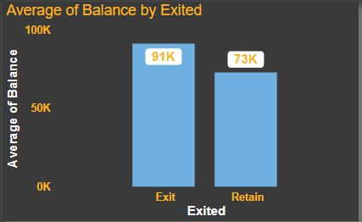
OBJECTIVE KEY FINDINGS
DISTRIBUTION OF CHURN BY CREDIT CARD
TREND OF CUSTOMER JOINING OVER YEARS
AVERAGE BANK BALANCE OF CUSTOMERS CHURNED
Churn among credit cardholders may signal dissatisfaction with the features, benefits, or terms of the credit card product itself or inability to manage credit card.
By credit card utilization patterns and spending behaviors of churned customers to identify any trends or insights strategies shall be implemented.
It suggests positive growth and expansion in the customer base.
However it is also necessary to manage the churn & retention rate for increasing the numbers of customer base.
Effective marketing strategies and campaigns may contribute to attracting more new customers.
Decision to leave the bank despite having a higher balance could indicate dissatisfaction with other aspects of the banking relationship, such as service quality, product offerings, or customer experience.
Implementing targeted retention efforts, such as relationship pricing, premium services, or VIP treatment for high-balance customers, can help incentivize them to stay with the bank.

Slide 9
OBJECTIVE KEY FINDINGS
AGE GROUPS HAVING CREDIT CARD
CUSTOMER CHURNED/COUNTRY
AVERAGE BANK BALANCE/COUNTRY
Understanding credit card usage patterns across different age groups can help the bank tailor retention strategies and product offerings to meet the diverse needs and preferences of customers.
Implementing targeted marketing campaigns, rewards programs, or financial education initiatives can encourage usage of credit cards among younger and older demographics .
Intense competition among banks in France and Germany could result in higher customer churn as customers switch between providers to seek better deals, rates, or services.
Other reason can be the lack of services or mismanagement at France & Germany.
This gap should be rectified and services shall be updated for retention of customers.
Average bank balance of customer at Germany is highest but the customer churn at Germany is also high ,this indicates there is a lack of management or services at Germany branch.
Management can use feedback & surveys from aal branches & compare it to find the gap that is there in Germany branch & two other.

Slide 10
SUBJECTIVE KEY FINDINGS
New customers & old customers maintain similar savings habits, and financial behaviours, spending habits leading to consistent average bank balances.
Old customers avails credit cards as well as other services more compared to New customer are more loyal to the bank.
Credit cards & internet banking is the most used products.
Churn rates & account activity’s are dependent upon the fluctuations of economic indicators in countries.
Lower aged, old aged, unemployed/freelancing job appears to be customers at risk of churning .
Common characteristics such as female gender ,age groups between 30-50 and trends such as customers having credit card and from Germany & France was identified among customers who have exited.
Churn rate for 2017 was found to be the highest and 20% is the overall churn rate.
Customers in age group 30-50,inactive users, users using less numbers of products were found to be at a higher risk of churning the bank.

Slide 11
STRATEGIC RECOMENDATIONS
Females were found to be having higher average salary(potential revenue generator) but their churning rate were also high.
This indicates management to understand why females are churning the bank more.
Gender specific services shall be provided & is important for retention of potential revenue generators.
Considerable % of accounts are not active , this is the indicator to management to launch campaigns to re-engage inactive account holders through personalized communication channels, such as email, SMS, or direct mail offering incentives, promotions, or rewards to encourage them.
Implementing targeted retention efforts, such as relationship pricing, premium services, or VIP treatment for high-balance customers, can help incentivize them to stay with the bank.
Branches at FRANCE & GERMANY shall be looked up at priority for redesigned strategies for retention of customers.
Digital services & Credit card services shall be promoted & special awareness campaigns regarding them shall be planned as these service can be the potential high revenue generators.

Slide 12
CONCLUSION
The dataset of Columbia bank was analysed thoroughly and management can move in the below mentioned direction for effective customer churn management and growth in customer retention.
Key factors contributing customer churn were identified as :
Customers using less numbers of products.
Absence of segment wise specific services.
Branches at Germany & France has services & management gaps.
Significant inactive users at France branch.
Profitable customer segments identified as :
Female customers.
Branches at Germany & France.
Customers aged 30-50 years.
It should be aimed to achieve more % of active users.
Digital services , tailored services , prompt customer services , ease of banking are amongst the pillars for getting growth.

Slide 13
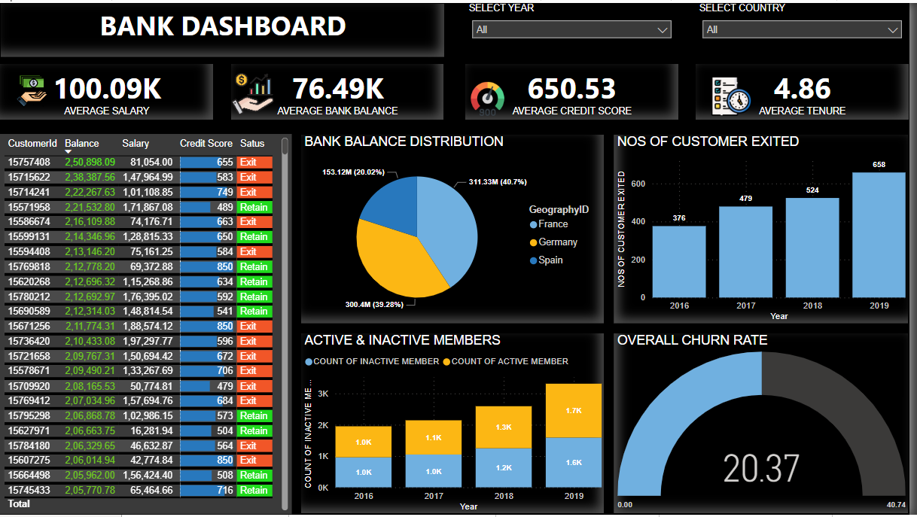
DASHBOARD

Slide 14
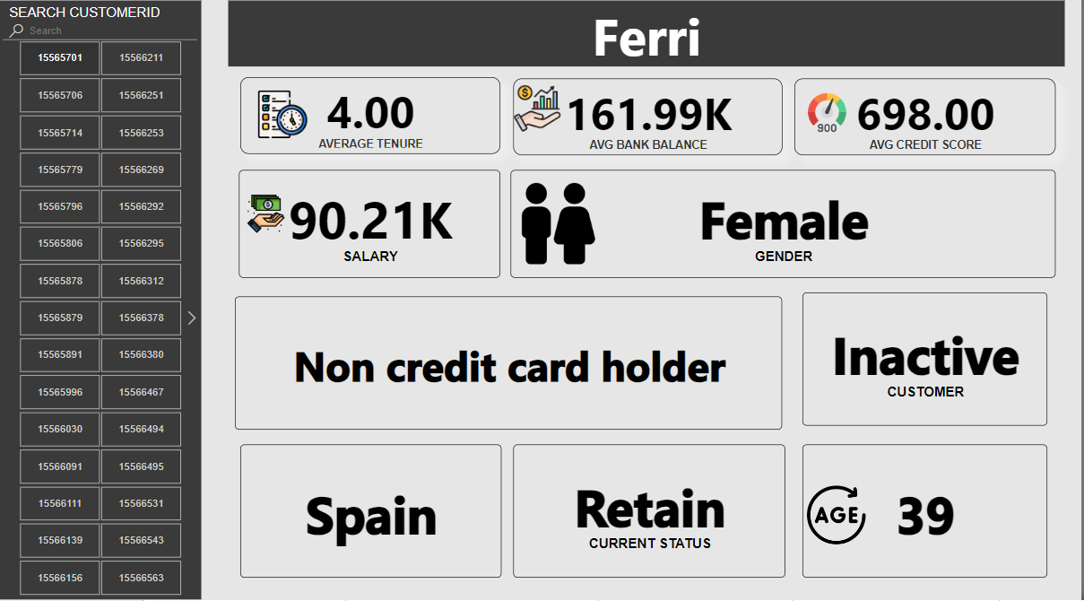
DASHBOARD

Slide 15


Thank you
nandanwarpratik7@gmail.com
www.linkedin.com/in/pratik-nandanwar

